Slide 1


JS QCM

Slide 2
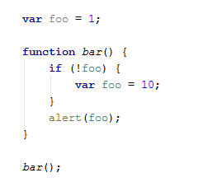
Question 1
Q : give the value of foo in the popup
Notes:
Tested Knowledge : JS function scope vs java like block scope
Code :
'use strict'; var foo = 1; function bar() {
if (!foo) { var foo = 10; } alert(foo); } bar();
Solution :
var foo; function bar() { var foo; if (!foo) { foo = 10; } alert(foo); } foo = 1; bar();
SOLUTION = 10

Slide 3
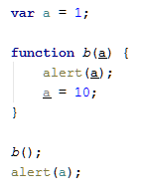
Question 2
Q: give the value of a in the first popup, and second popup
Notes:
Tested Knowledge : method param are scoped to the method, and primitive method param are passed by copy
var a = 1; function b() { a = 10; return; function a() { } } b(); alert(a);
SOLUTION =
Undefined
1

Slide 4

Question 3
Q: give the value of r2
Notes:
Tested Knowledge : || logical syntax
var a; var r2 = a || {name: 'toto'}; console.log(r2);
SOLUTION = {name: 'toto'}

Slide 5

Question 4
Q: give the value of r2
Notes:
Tested Knowledge : && logical syntax
var c=10; var r2 = c && function(){ var b = 3+8;alert(b); return b;} && "tt"; console.log(r2);
SOLUTION = "tt"

Slide 6
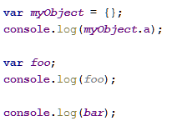
Question 5
Q: give each value of :
myObjet.a
foo
bar
Notes:
Tested Knowledge : value of an undefined / undeclared var depending if it's a property or directly a var
SOLUTION =
undefined
undefined
Uncaught ReferenceError: bar is not defined (in fact not declared !)

Slide 7
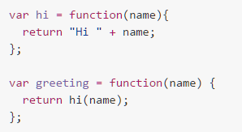

Question 6
Function
first
second
Q: Assuming that the function 'hi' is defined as above in the code, which version of the "greeting" function are functional ? First, second or both ?
Notes:
Tested Knowledge : a function is a var
SOLUTION = both

Slide 8
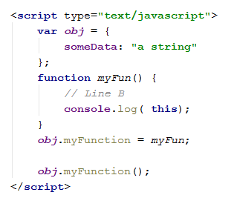
Question 7
What is this ?
Q: what is 'this' when shown on the console ?
Notes:
Tested Knowledge : this on an object
SOLUTION = Object {someData: "a string"}
idem to :
myFun.call( obj); => set the 'this' to obj for that call.
myFun.apply( obj);
var functionForLater = myFun.bind(obj);
functionForLater () ; // this is obj

Slide 9
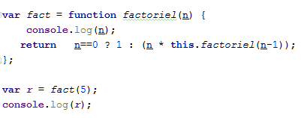
Question 8
Q: It does not work ? Why ?
Idea to make it work ?
Notes:
Tested Knowledge : this is not the function itself !
this is GLOBAL
factoriel is just a local name within the function expression.
On the global scope you just have the function fact.
remove 'this.'

Slide 10
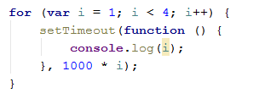
Question 9
Scope again
Q: What is the result printed on the console ?
Notes:
Tested Knowledge : a classic closure
after 1000 ms => 4
after 2000 ms => 4
after 3000 ms => 4
Solution 1
for (var i = 1; i <4; i++) { setTimeout(function (x) { return function () { console.log(x); }; }(i), 1000 * i); // 1 2 3 }
Solution1 clearer
function myCallBackClosured(x) { return function () { console.log(x); }; } for (var i = 1; i <= 5; i++) { setTimeout(myCallBackClosured(i), 1000 * i); // 1 2 3 4 5 }
Solution 2
for (var i = 1; i <= 5; i++) { (function (i) { setTimeout(myCallBack, i * 1000); function myCallBack() { console.log("i: " + i); } })(i); // 1 2 3 4 5 }

Slide 11
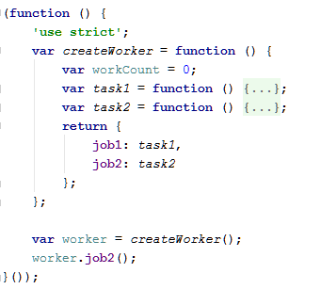
Question 10
I.I.F.E.
Q: What is the objective of (function() { …some JS code …. } ()); syntax ?

